Slide 1
Virtual USB
Shanpei Chen
CPD-Platform Team

Slide 2
Agenda
The Introduction of USB
Basic Terms
USB Spec
Topology
Data flow
Descriptor
VMware Virtual USB
Architecture
Device connect / disconnect
Logging & Trouble Shooting
Logs
Tools

Slide 3
Basic Terms
Host Controller （HC）
Hub & Root Hub
Port
Endpoint (EP0)
Pipe
Function
Device Address (Default Address 0)
Frame
Packet

Slide 4
USB Spec
USB 1.1 (UHCI, OHCI)
Low Speed (1.5MB/s), Full Speed (12Mbps)
USB 2.0 (EHCI)
Low Speed , Full Speed, High Speed (480Mbps)
USB 3.0 (xHCI)
Compatible with 2.0, Super Speed (5Gbps, 10bps)
USB OTG
Host
Device
Device
Device

Slide 5
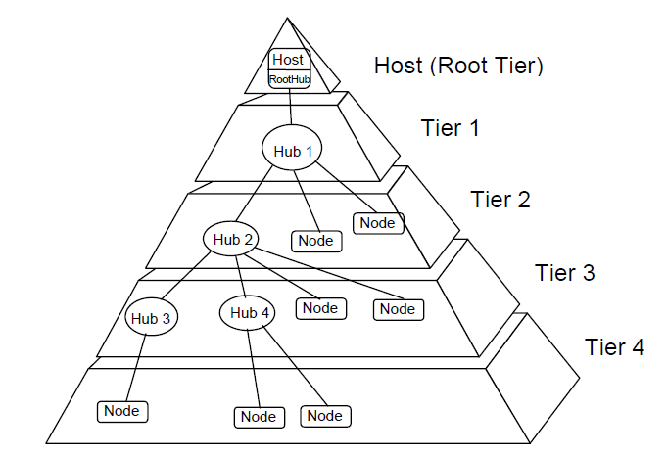
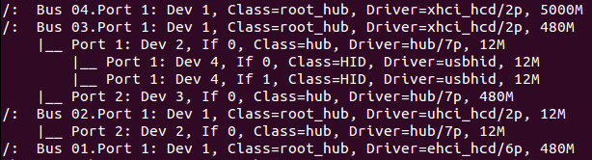
Physical USB Topology
PCI Bus

Slide 6
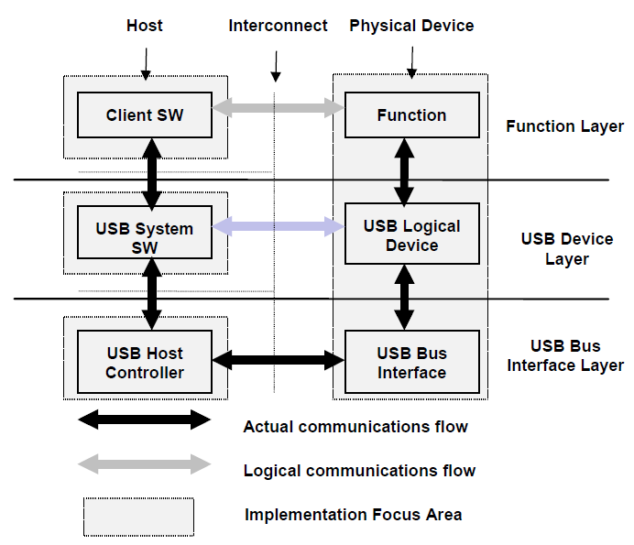
USB Data Flow Model

Slide 7
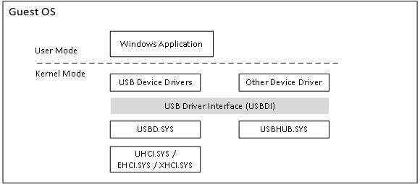
Windows USB Driver System

Slide 8
Data Flow Type
Control Transfers
Init & Configure USB device
Special data structure
Bulk Transfers
Large amounts of data, the data is sequential.
No latency requirement
Interrupt Transfers
Small data package， low latency
Isochronous Transfers
Isochronous data is continuous and real-time
bandwidth required
No ERROR Detection

Slide 9
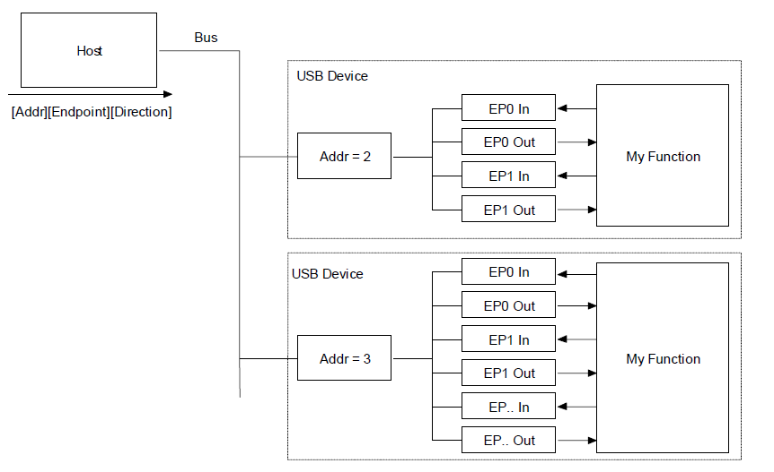
Singe Packet Transfer
Packet

Slide 10
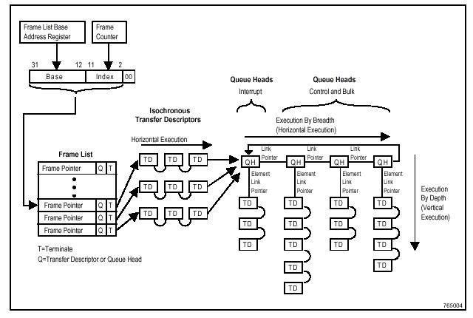
Multi-Packet Transfer

Slide 11
Descriptor
Definition
A descriptor is a data structure with a defined format.
USB devices report their attributes using descriptors.
Descriptor Type
Device Descriptor
Describe general information about a USB device.
Length, Class, subclass, vender ID, product ID, Number of Configurations
Configuration Descriptor
Describe information about a specific device configuration.
Length, Config characteristics (Self-Power, Remote Wakeup), MaxPower, Number of Interface

Slide 12
Descriptor
Descriptor Type (Continue)
Interface Descriptor
Describe a specific interface within a configuration
Length, Interface Class & Subclass, Number of Endpoint
Endpoint Descriptor
Length, Transfer Type (Control, Isochronous , Interrupt, Bulk), Endpoint Address, Max Packet Size

Slide 13
Descriptor Relationship
Only one == >
Device Descriptor
Only One active configuration, determined at device init
Configuration 0
Configuration 1
Driver object
Interface 0
Interface 1
Interface 2
EP1
EP2
EP3
EP4
EP5
EP0 belongs to every Interface

Slide 14
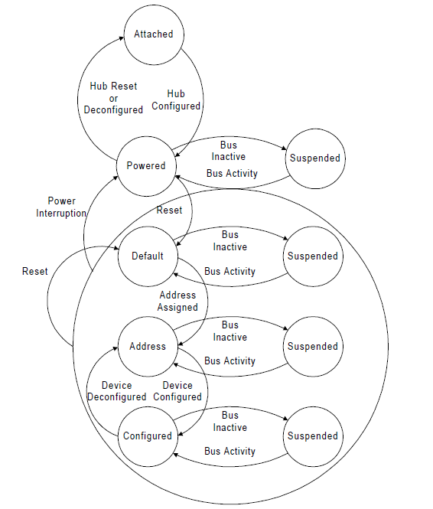
Device State Diagram

Slide 15
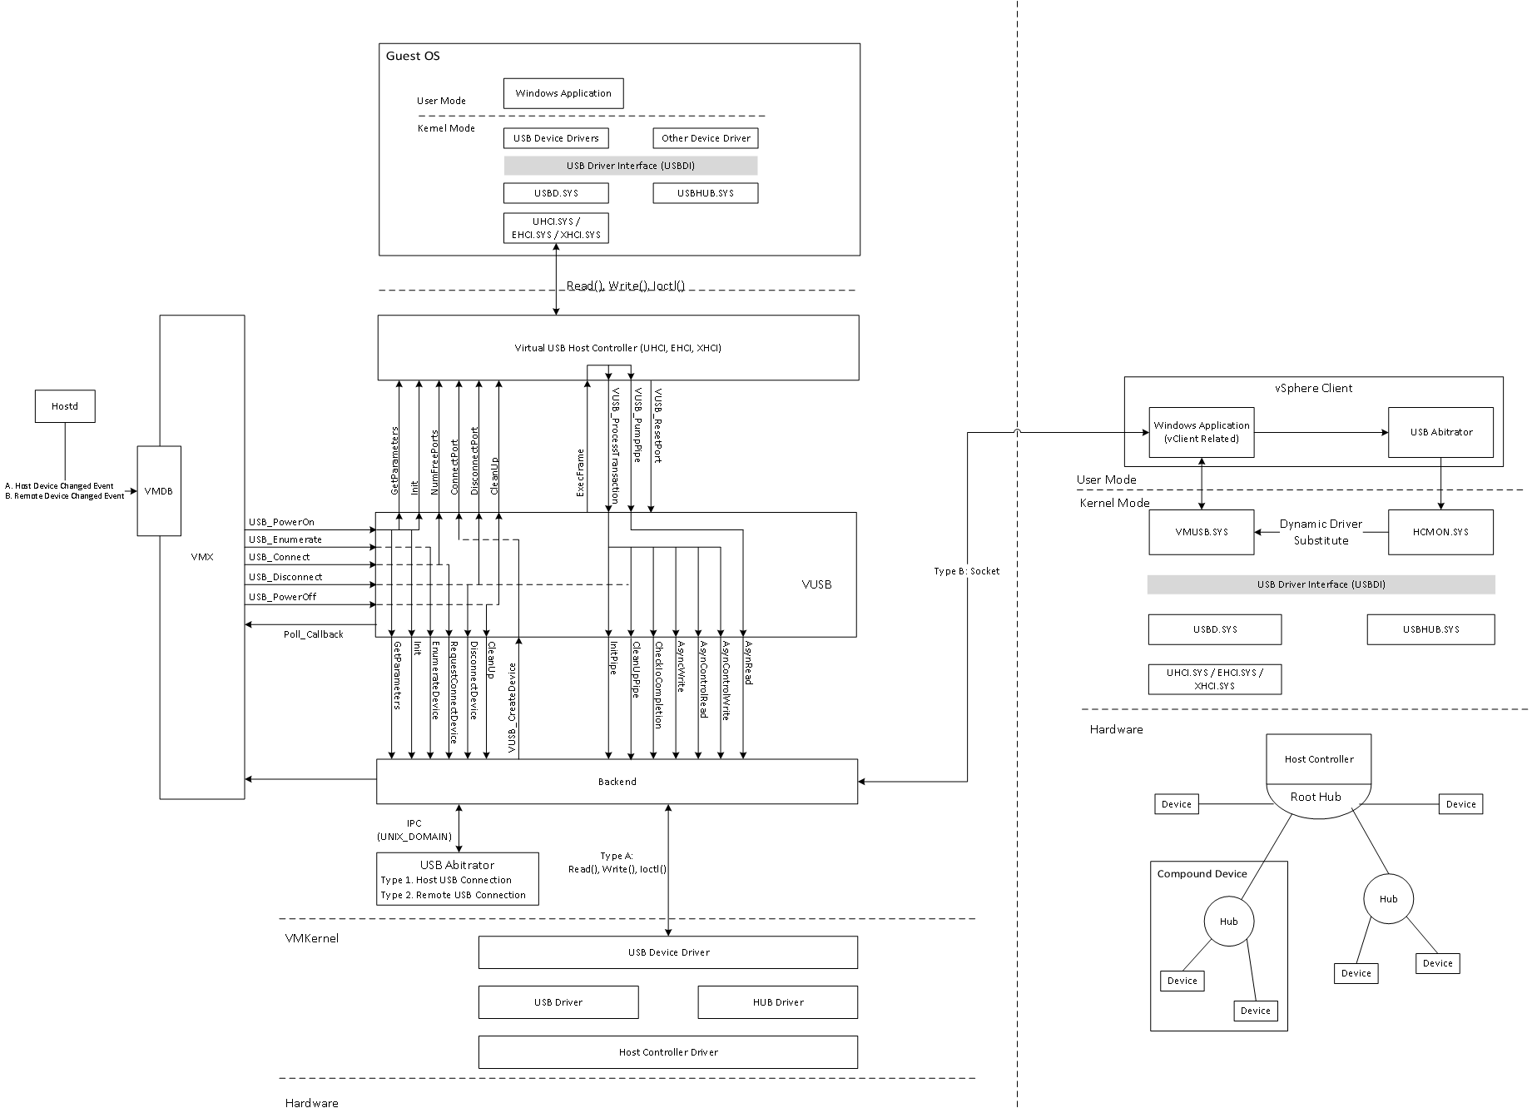
VMware USB Architecture

Slide 16
Logs
vmware.log
VUSB Poweron, Init, USBIO, Device connect & disconnect
Arbitrator log
Record the connection / disconnection between VM and Devices
Hcmon log
Dynamic driver substitute
Filter & Change special Control Message
Hostd log
Record the USB device change event.
https://wiki.eng.vmware.com/USBBugGuidelines

Slide 17
Tools
lsusb
-t: Dump the physical USB device hierarchy as a tree
-v: show USB device’s descriptors
Usbview.exe
The same as lsusb, but on Windows
Virtual USB Analyzer
http://vusb-analyzer.sourceforge.net/tutorial.html
USB wireshark
http://esec-lab.sogeti.com/post/2011/04/06/Sniffing-USB-traffic-with-VMWare

Slide 18
Q & A
Thanks

